Slide 1





Slide 6
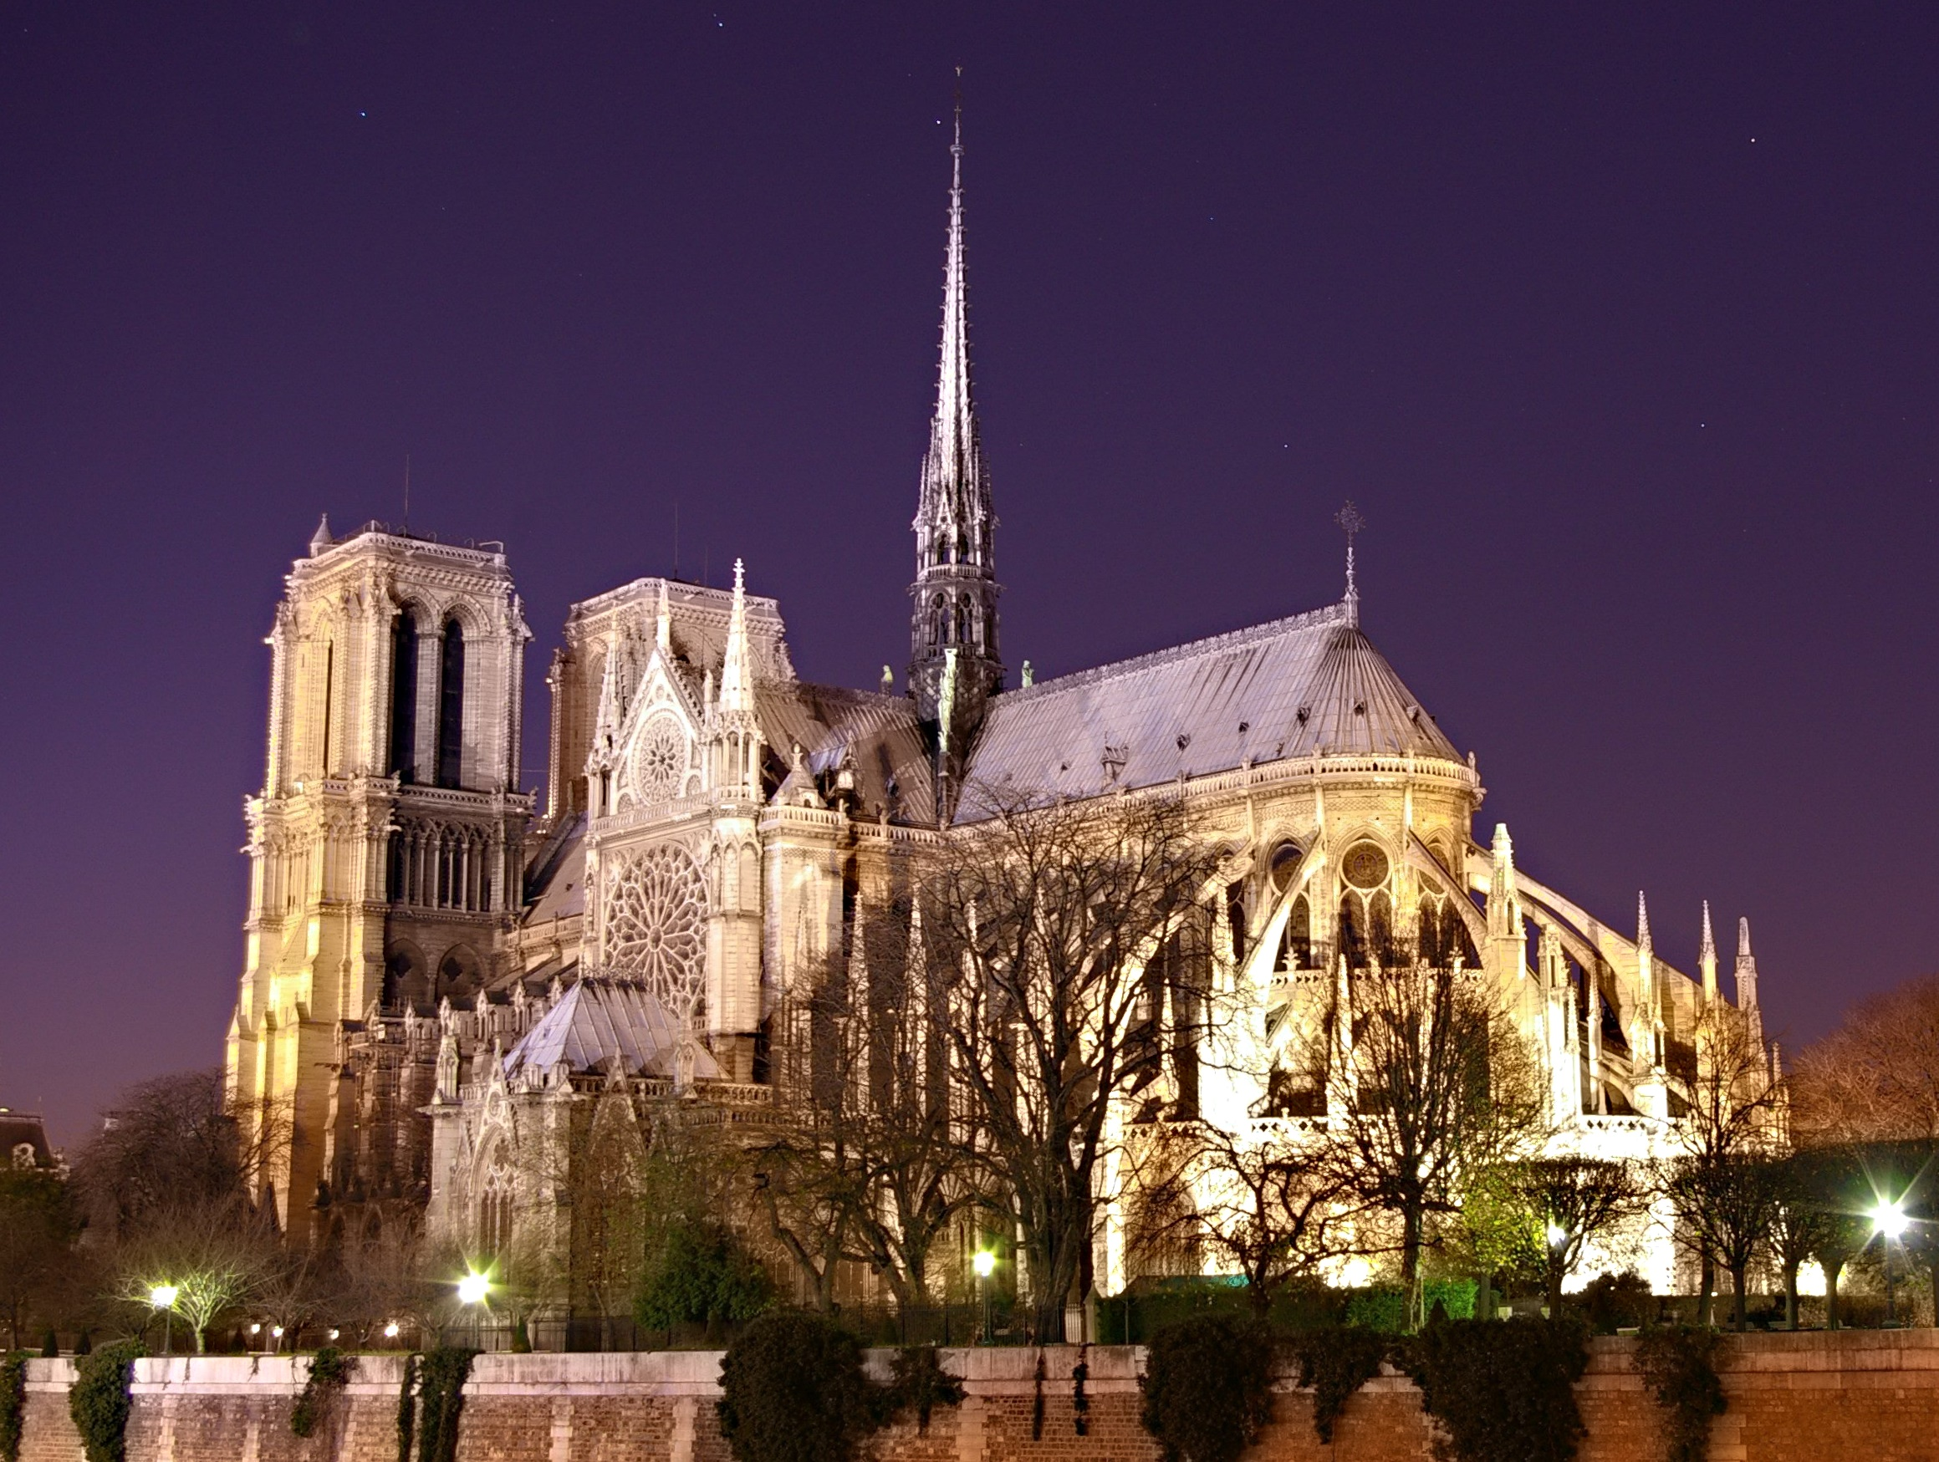
PARIS PHÁP
This Photo by Unknown Author is licensed under CC BY-SA

Slide 7

O
E
A
N

Slide 8
